Slide 1

Data Exploration on NYC Airbnb
By: Reagan L. Tiburan

Slide 2
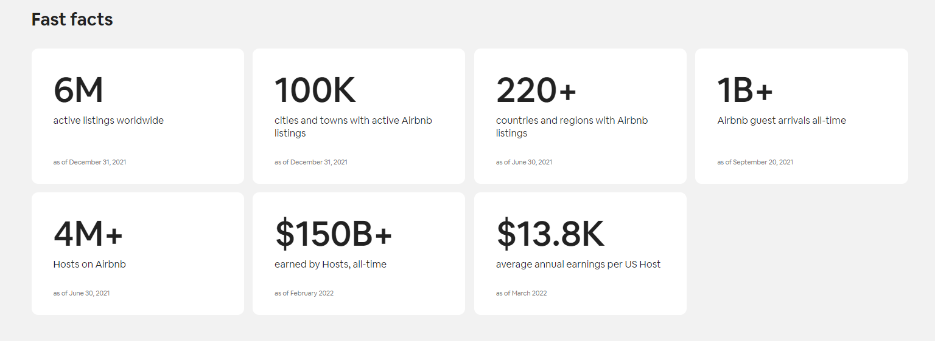
Airbnb was born in 2007 when two Hosts welcomed three guests to their San Francisco home, and has since grown to 4 million Hosts who have welcomed more than 1 billion guest arrivals in almost every country across the globe. Every day, Hosts offer unique stays and one-of-a-kind activities that make it possible for guests to experience the world in a more authentic, connected way.

Slide 3
Description of the data:
Context:
Since 2008, guests and hosts have used Airbnb to expand on traveling possibilities and present more unique, personalized way of experiencing the world. This dataset describes the listing activity and metrics in NYC, NY for 2019.
Content:
This data file includes all needed information to find out more about hosts, geographical availability, necessary metrics to make predictions and draw conclusions. It has around 49,000 observations in it with 16 columns and it is a mix between categorical and numeric values.
Acknowledgements:
This public dataset is part of Airbnb, and the original source can be found on this website.(http://insideairbnb.com/)

Slide 4
Breakdown of this presentation:
Data Information
Data Dictionary
Data info / Head
Data Cleaning:
Dropping duplicates, unnecessary values
Creating a new columns
Missing Values Summary
Remove less than 5% missing values from the dataset
Impute missing values
Changing Data types and creating a new column
Transformations
EDA: Using plots to find relations between the features.
Correlation between different features
New York AirBnb Map
Word Cloud Neighbourhood
Map per Neighbourhood
Listings per Neighbourhood Group and Room Type
Listings per Neighbourhood Group and Year
Differences Between Neighbourhood Group and Room Type
Listings per Availability_365 (Fully / partially Booked)
Fully Booked Listings per Neighbourhood Group and Room Type
Average Price of Neighbourhood Group per Year
Total Rentals $ per Year
Busiest Host

Slide 5
4. Algorithm (Price Prediction- Regression)
BaggingTreesRegression
RandomForestRegression
DecisionTreeRegressor
LinearRegression
XGBRegressor
5. Algorithm ( Room Type Prediction - Classification)
LogisticRegression
RandomForestClassifier
DecisionTreeClassifier
KneighborsClassifier
6. Conclusions and Recommendations

Slide 6
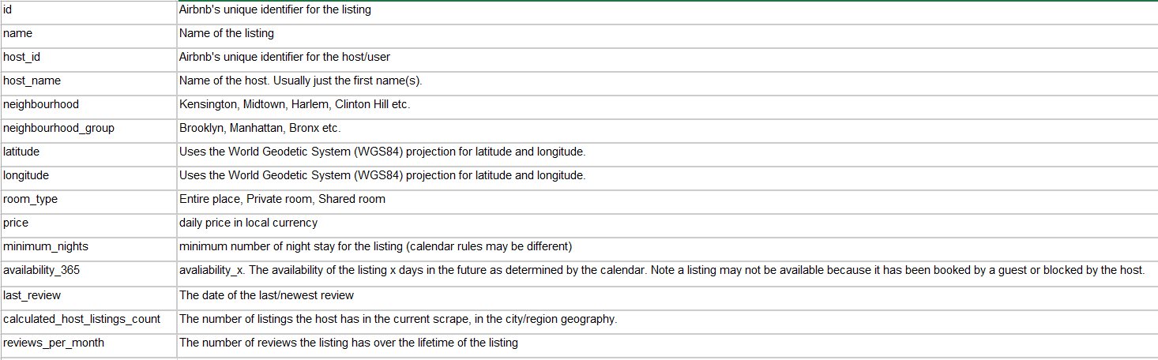
1. Data Information
Data Dictionary

Slide 7
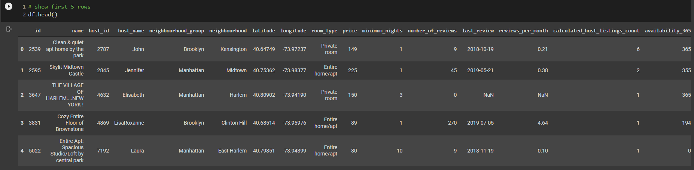
Data Info / Head

Slide 8
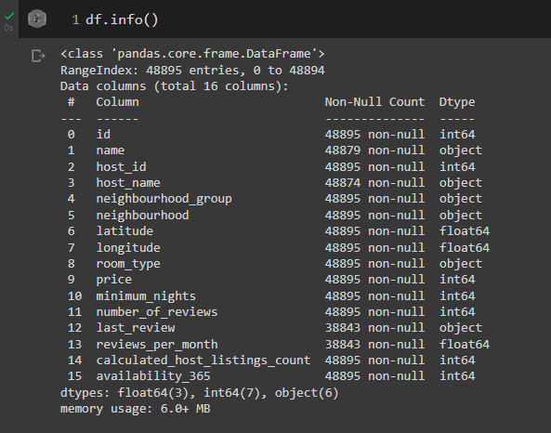

Slide 9
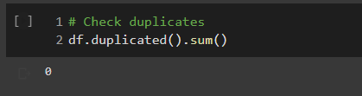
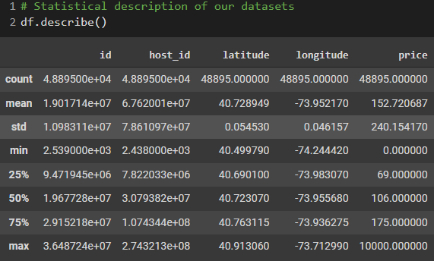
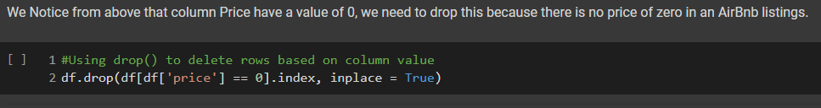
2. Data Cleaning:
Dropping duplicates, unnecessary values

Slide 10
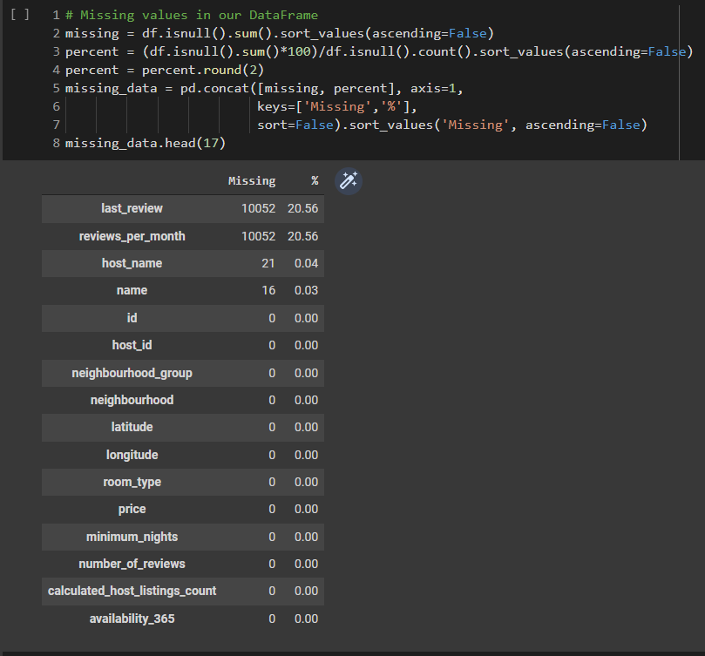
Missing Values Summary

Slide 11



Remove less than 5% missing values from the dataset
Impute missing values

Slide 12
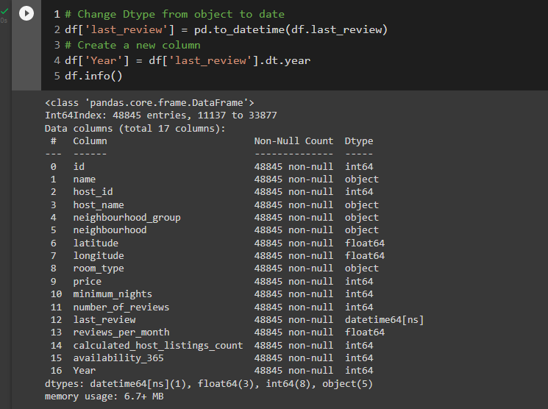
Changing Data types and Creating a new column

Slide 13
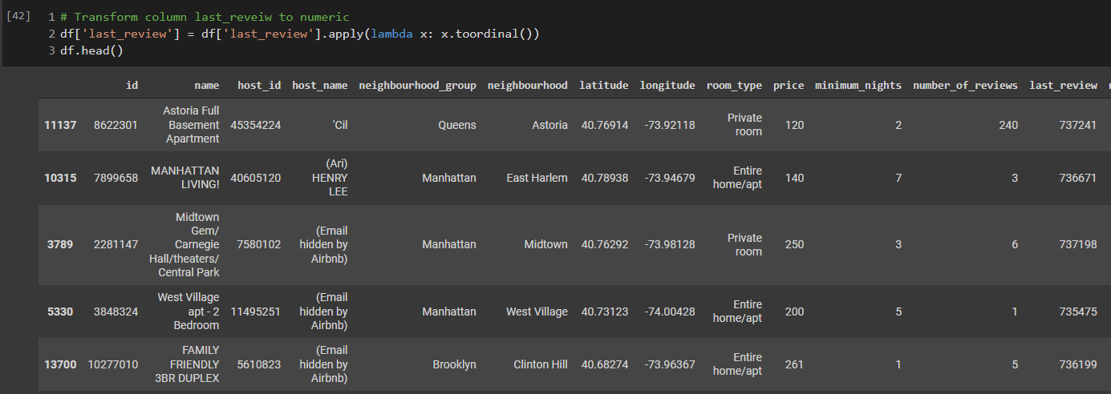
Transformations

Slide 14
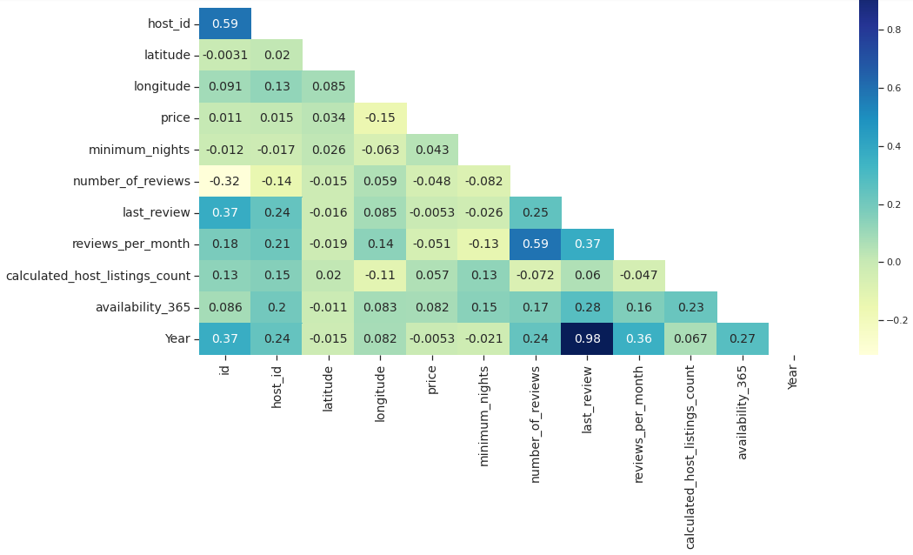
3. EDA: Using plots to find relations between the features.
What are the Correlation between different features?

Slide 15
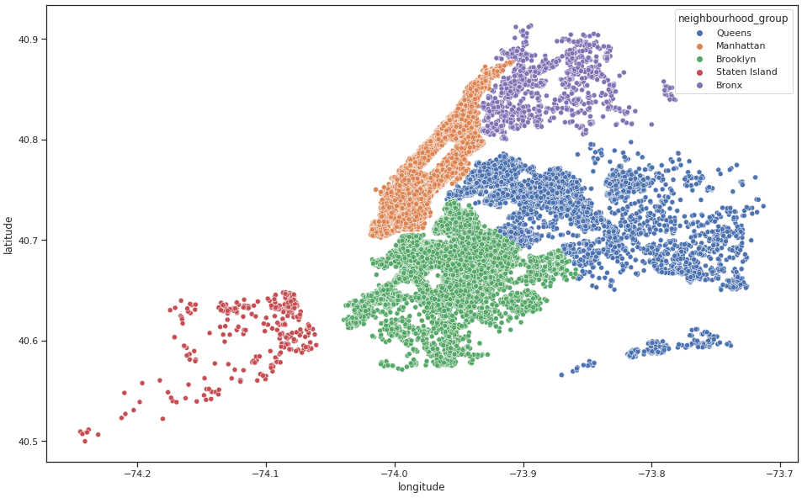
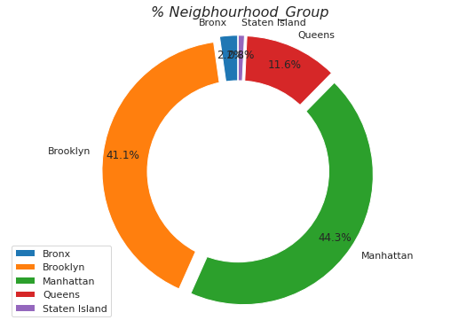
New York AirBnb Map

Slide 16
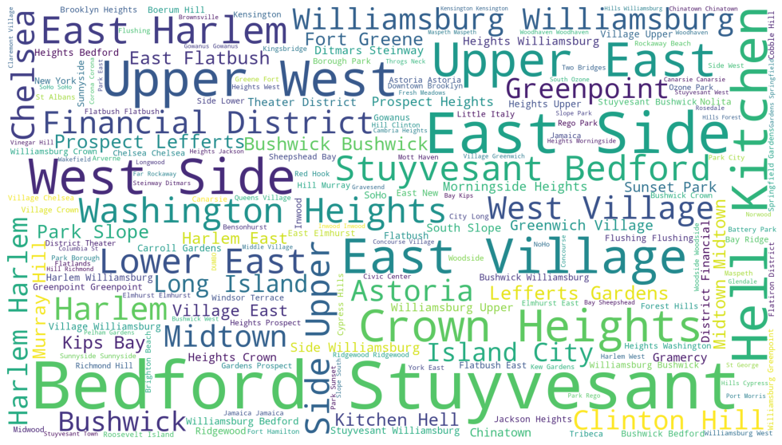
Word Cloud Neighbourhood

Slide 17
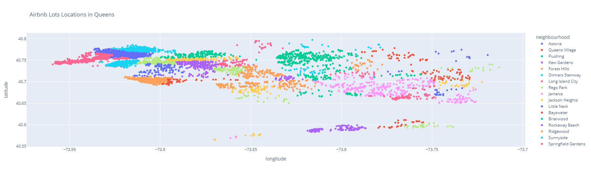
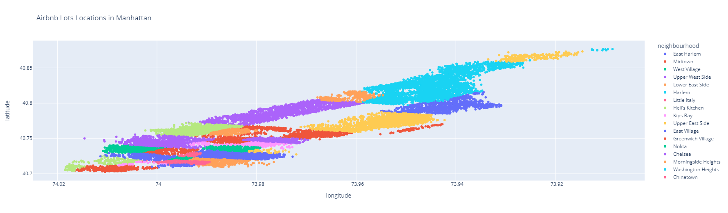
Map per Neighbourhood

Slide 18
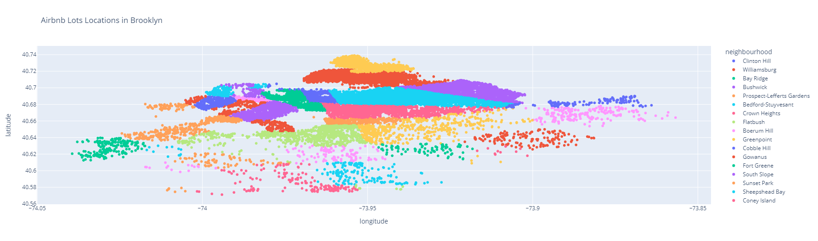
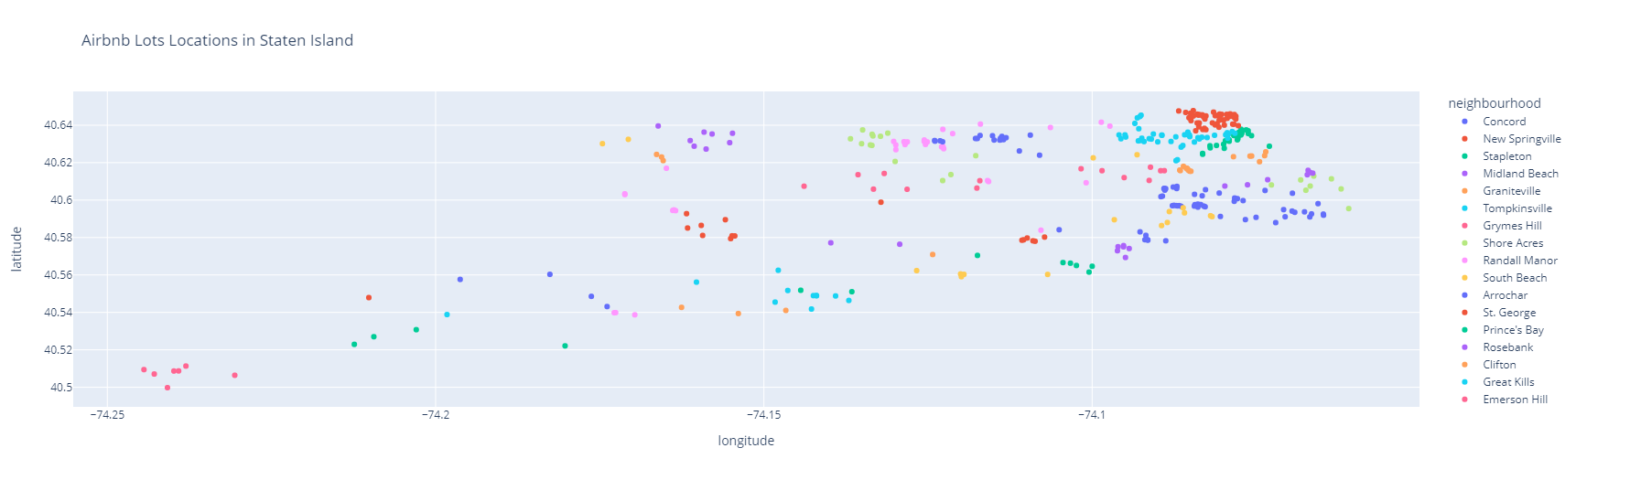

Slide 19
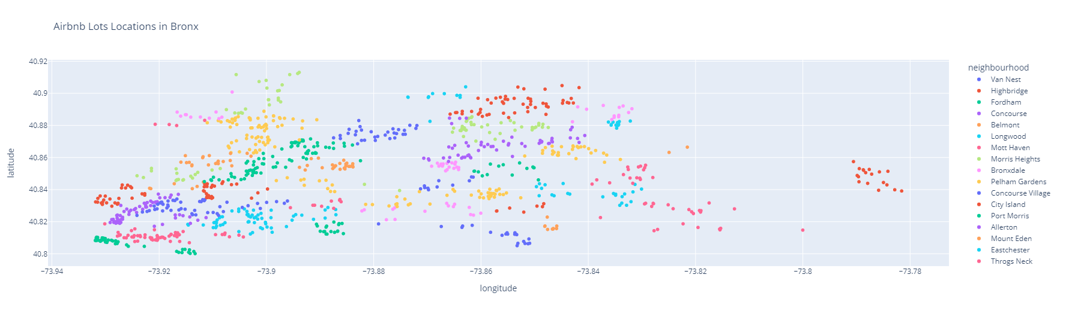

Slide 20
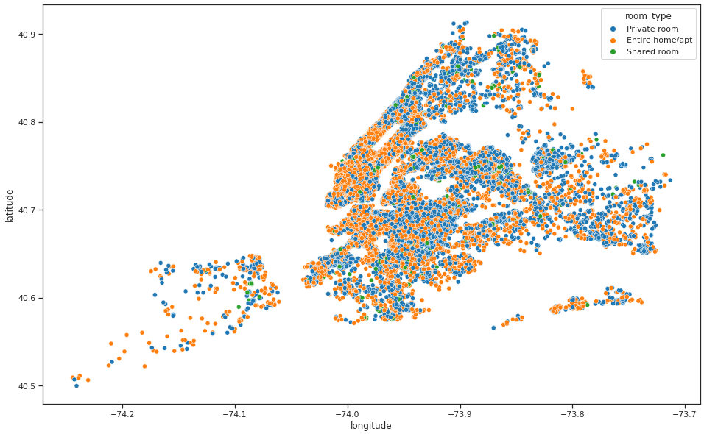
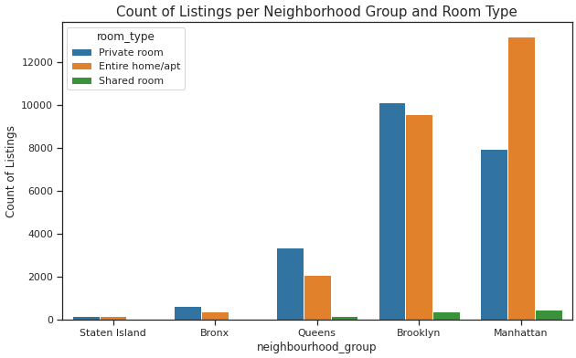
Listings per Neighbourhood Group and Room Type.

Slide 21
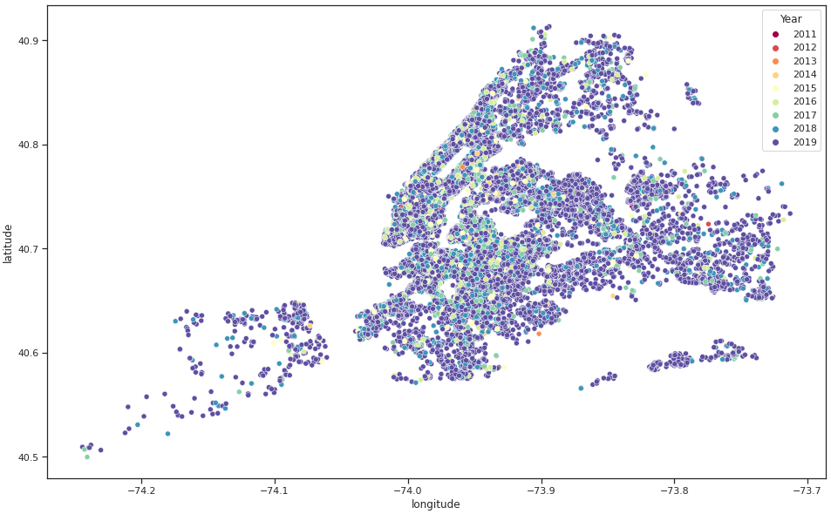
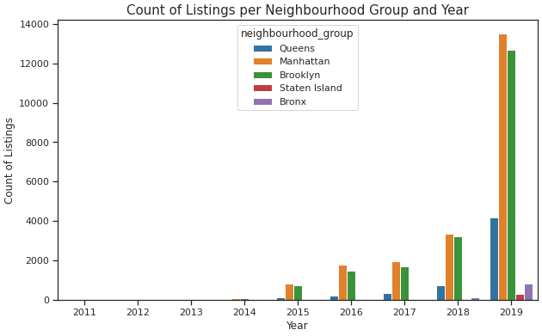
Listings per Neighbourhood Group and Year

Slide 22
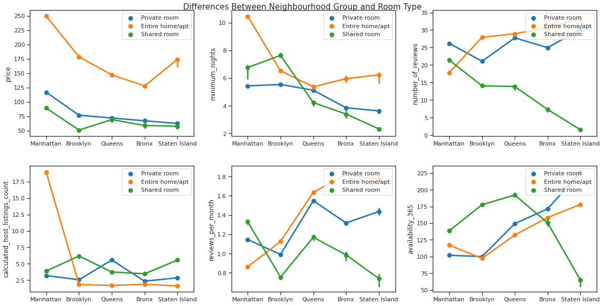
Differences Between Neighbourhood Group and Room Type

Slide 23
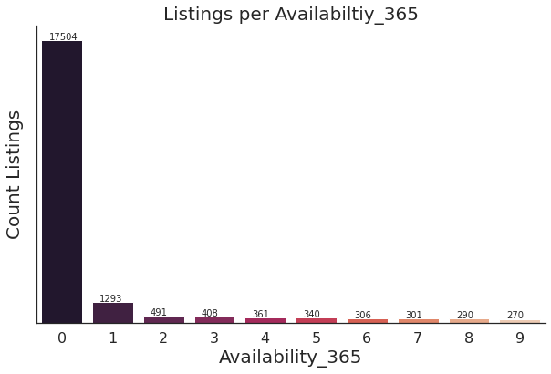
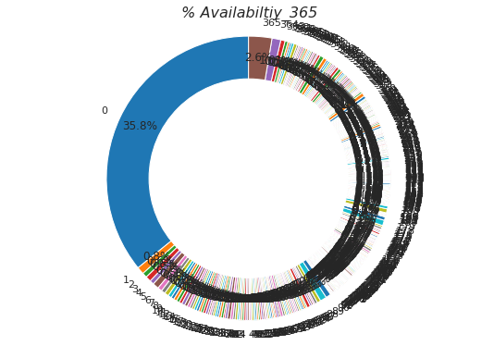
Listings per Availability_365 (Fully / partially Booked)

Slide 24
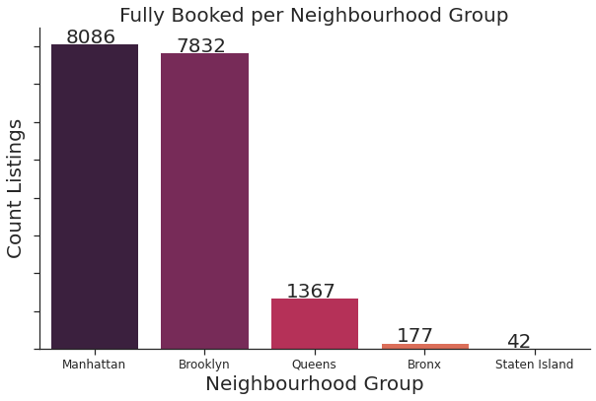
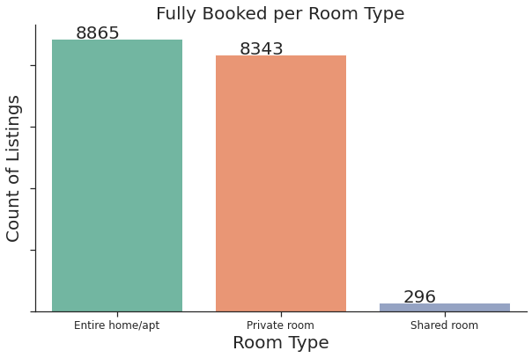
Fully Booked Listings per Neighbourhood Group and Room Type

Slide 25
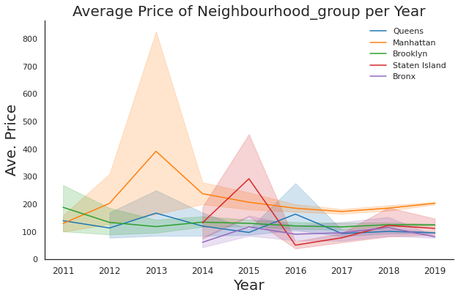
Average Price of Neighbourhood Group per Year

Slide 26
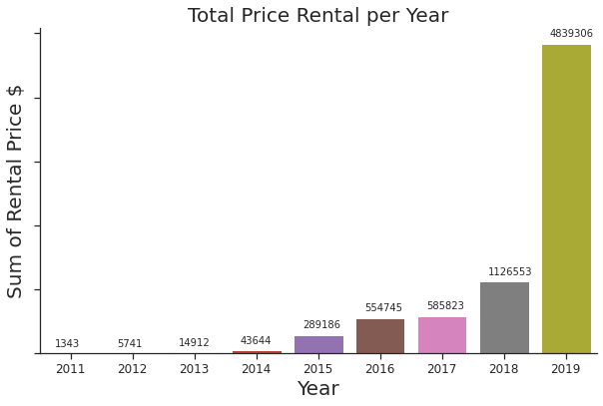
Total Price Rental $ per Year

Slide 27
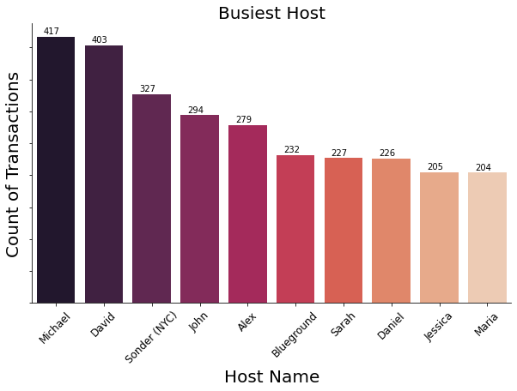
Busiest Host

Slide 28
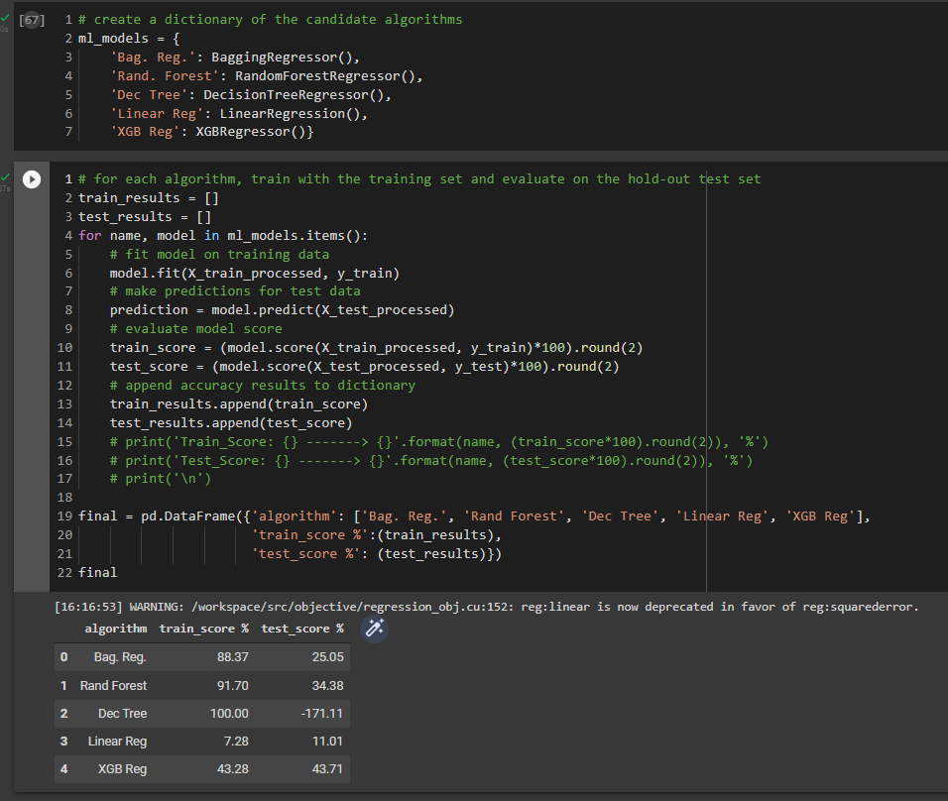
4. Algorithm (Price Prediction- Regression)

Slide 29
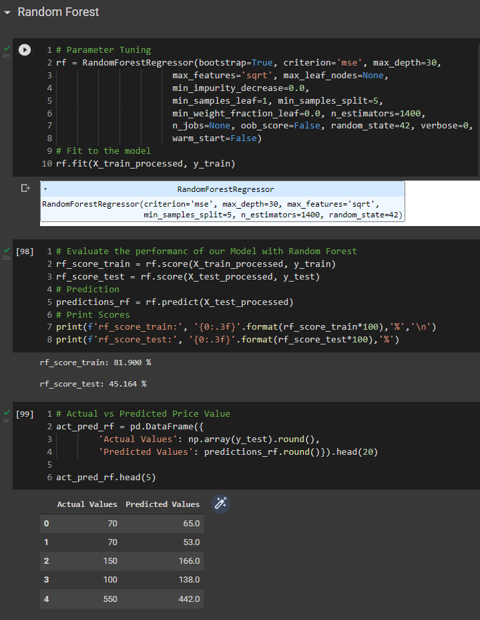
Choose the Best Model and applying parameter Tuning

Slide 30
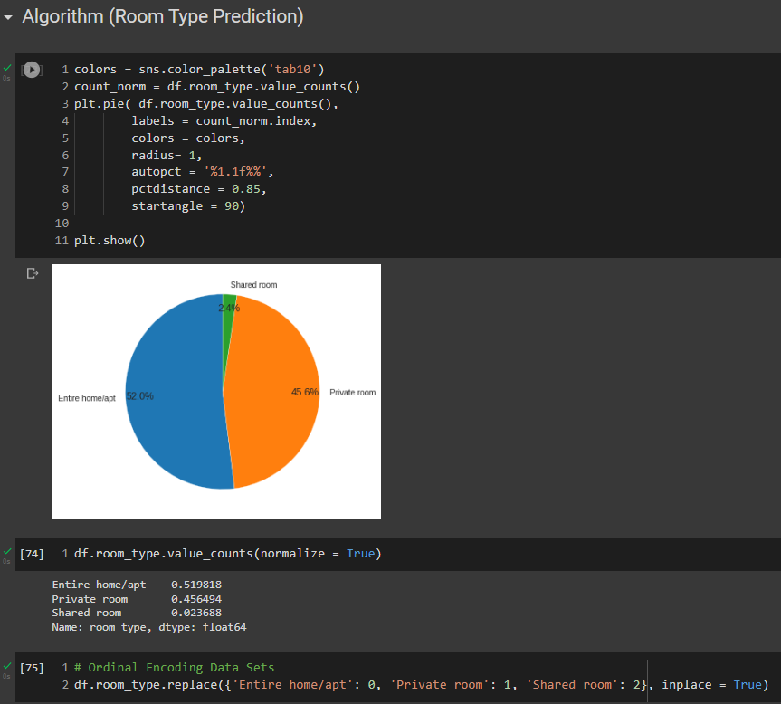
5. Algorithm ( Room Type Prediction - Classification)

Slide 31
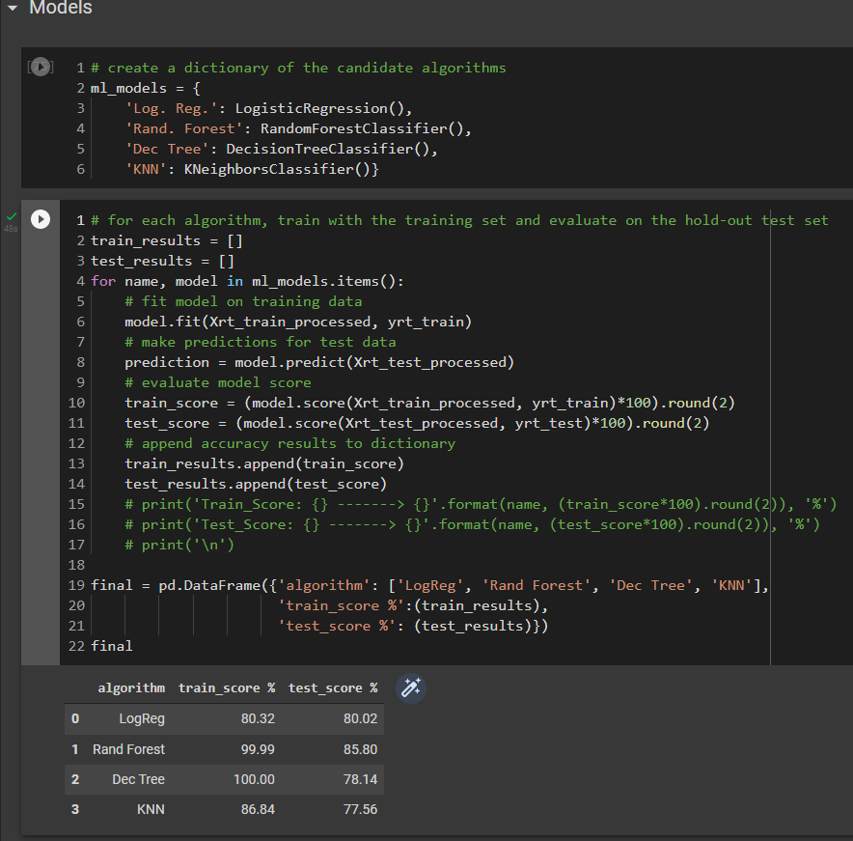
Model Selection with default parameters

Slide 32
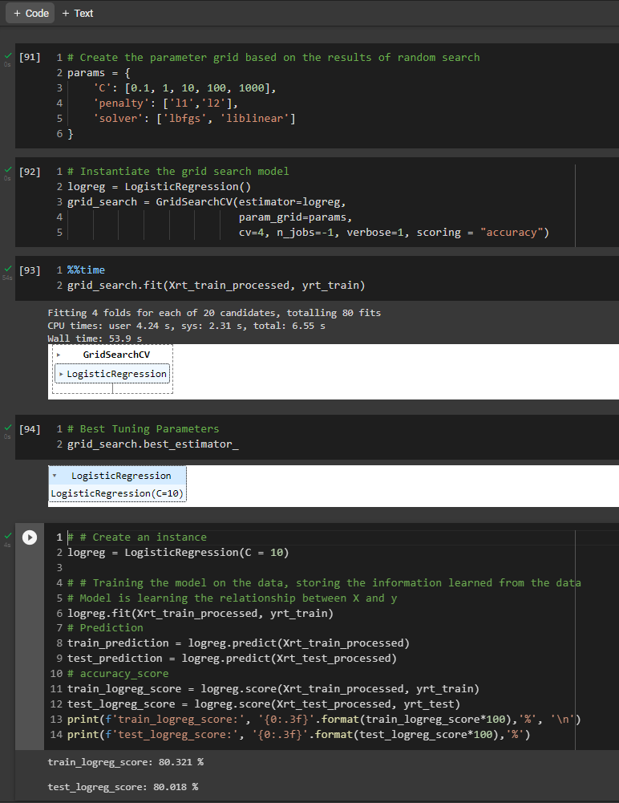
Choose the Best Model and applying parameter Tuning

Slide 33
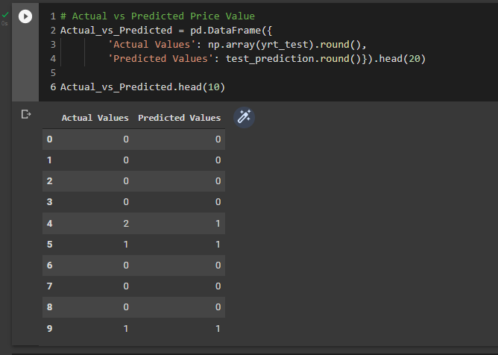
Choose the Best Model and applying parameter Tuning

Slide 34
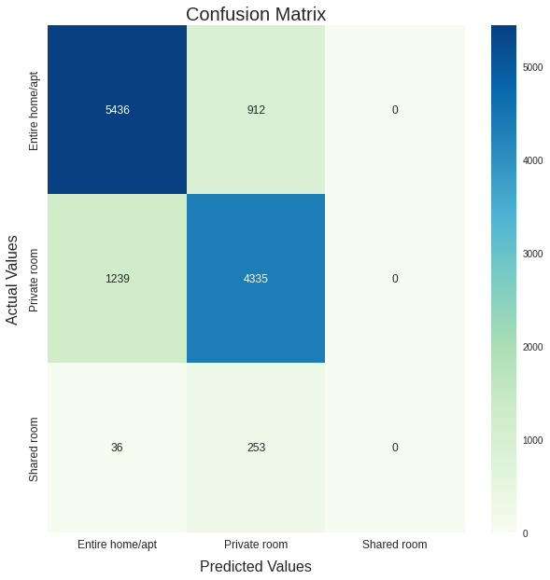
Metric to evaluate the model

